Slide 1

Chapter 12: Wave properties
Bishop Stopford School
faith | justice | responsibility | truth | compassion
All work to be done in your exercise book. If you run out of space, start another book.
Print out all worksheets. If you don’t have a printer, write answers in your book using FULL sentences.
ONLINE LEARNING
Print off specification sheet from:
https://bishopstopford.fireflycloud.net/science-2/school-closure-tasks/year-10-1/physics/triple-1/p12-wave-properties

Slide 2
P12 Lesson 3: Reflection and refraction
Week 2 (27th April to 3rd May)
Year 10
Triple physics

Slide 3
Learning objectives
Describe patterns of reflection and refraction of plane waves
Explain what happens to waves at a boundary of 2 different materials

Slide 4
Retrieval
From your KS3 knowledge, what is the Law of reflection?

Slide 5
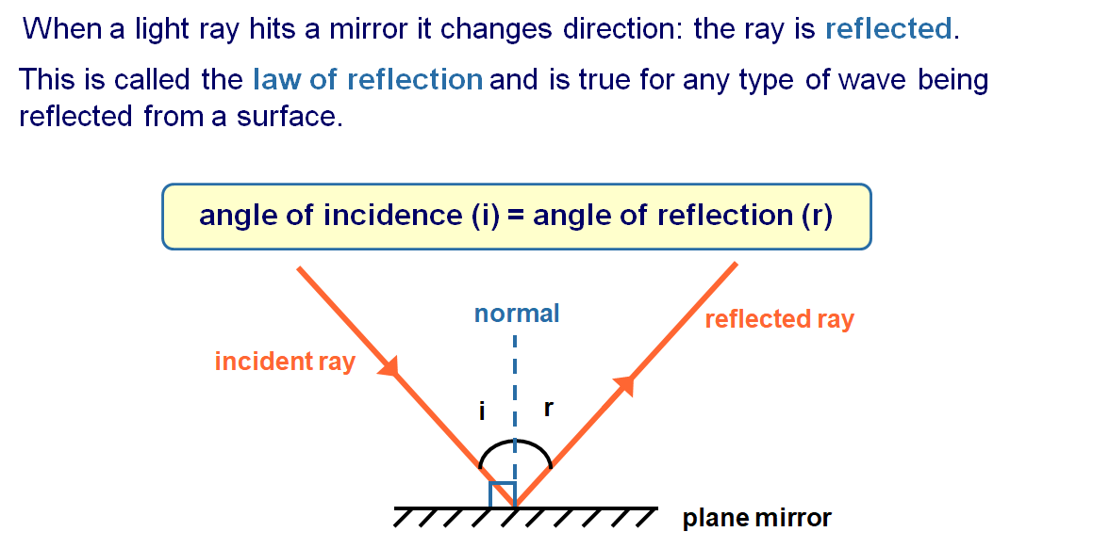
Retrieval: Answer

Slide 6
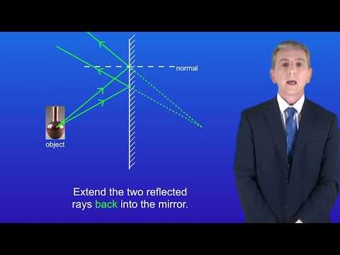
Acquire – watch the video on reflection
Make notes.
Pause or re-watch the video if necessary

Slide 7
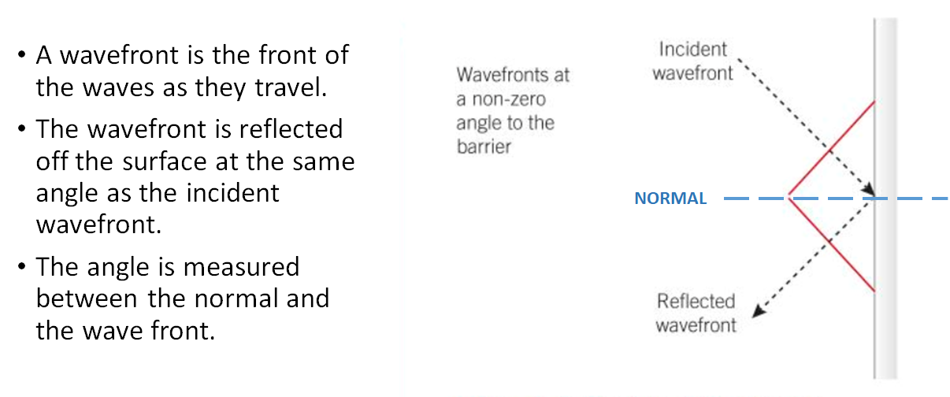
Acquire – reflection

Slide 8
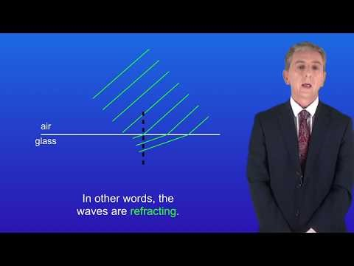
Acquire - watch the video on refraction
Make notes.
Pause or re-watch the video if necessary

Slide 9
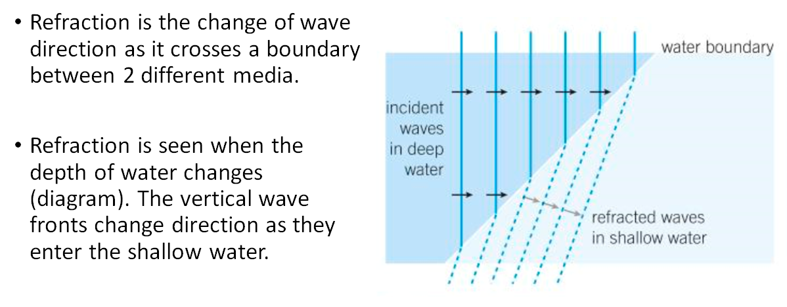
Acquire – refraction

Slide 10
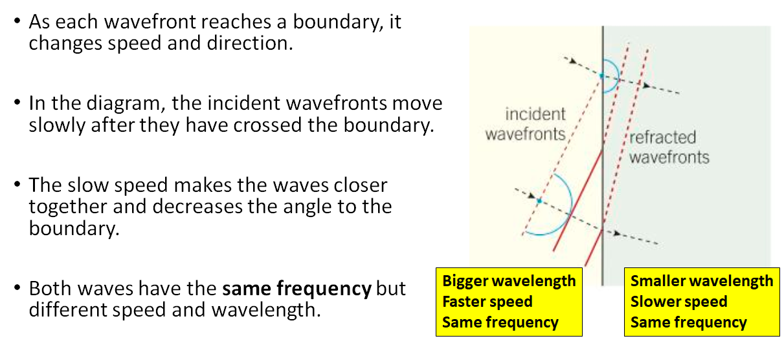
Acquire – explaining refraction

Slide 11
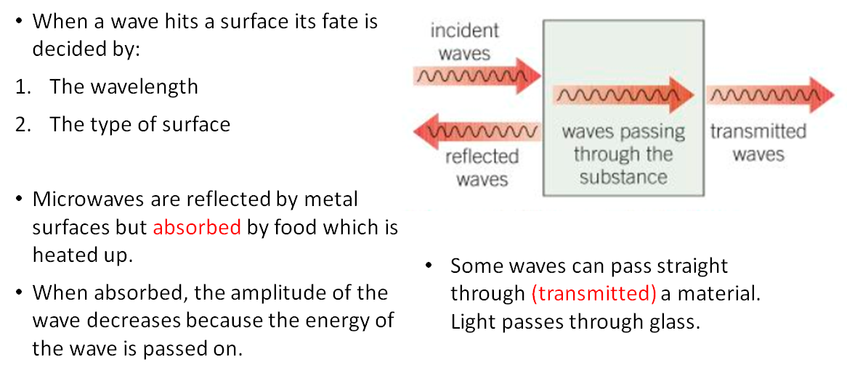
Acquire – fate of a wave

Slide 12
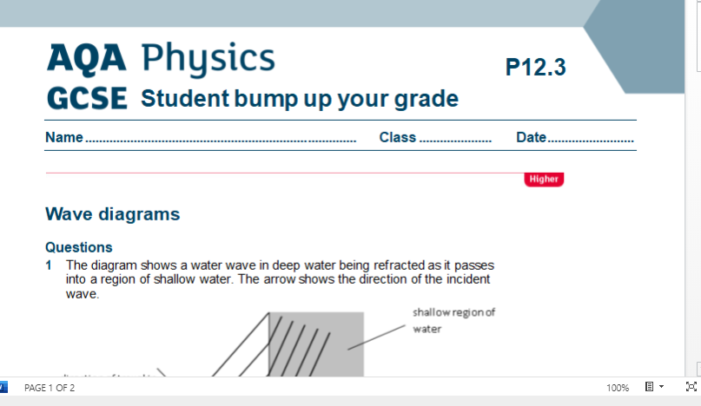
Action – worksheet
Access and print 2 pages per side from:
https://bishopstopford.fireflycloud.net/science-2/school-closure-tasks/year-10-1/physics/triple-1/p12-wave-properties
If you don’t have a printer, write full sentences in your book.

Slide 13
Review
1. Define the following:
Reflection
Refraction
Transmission
Absorption
2. What 2 factors affect the fate of a wave?

Slide 14
Review – can you….
Describe patterns of reflection and refraction of plane waves?
Explain what happens to waves at a boundary of 2 different materials?

Slide 15
Dig deeper (optional)
How would you use a ripple tank to find the wavelength, speed and frequency of water waves?
Write a step by step method.
Use the video to help you
https://www.youtube.com/watch?v=UNmv6H-f180

